Slide 1

DATA SCIENCE & APPLICATION PROJECT
MUWANI ROBSON
MUWANI ROBSON
CUSTOMER CHURN ANALYSIS : TELECOMS
Date: 29 May 2020

Slide 2

PRESENTATION OUTLINE
Background study
Objectives
Study Hypothesis
Study Framework
Descriptive Analysis
Research questions
Results/Findings
Conclusions & recommendations
Appendix/Tables/Graphs
SAS s/SAS Procedures
Q&A
CUSTOMER CHURN ANALYSIS : TELECOM

Slide 3

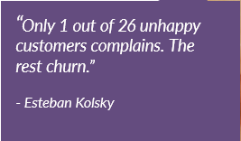
BACKGROUND STUDY
Telecom companies typically spend most of their effort and resources on customer acquisition, even though the cost of retaining an existing customer is five times lower than acquiring a new one.
Customer retention is a measure of how many of your customers continue to buy from you over time and are therefore loyal to your brand. Churn, sometimes known as customer attrition, is at the opposite end of the spectrum, i.e. the number of customers that stop buying from your company.
Telecom industry retention surveys show that while price and product/ service are important, most customers leave a service provider because of dissatisfaction with the way they are treated.
It costs hundreds of dollars to acquire a new telecom customer. When a customer churns, you not only lose the future revenue from this customer, but also the resources you spent on acquiring the customer in the first place.
This study aims to predict customer churn behavior and implore preventative strategies to avert customers from churning.

Slide 4
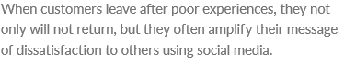
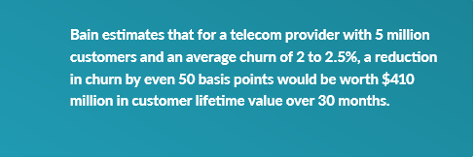
BUSINESS OBJECTIVE
How to increase customer LIFETIME VALUE( retention)
Promote actions that drive customer satisfaction, spend and loyalty
Analyse customer distribution and interactions across service platforms
Improve customer service delivery
Customer churn reduces profitability through revenue loss
Churn results in greater marketing and re-acquisition costs
The probability of selling to an existing customer is a lot higher than to a new prospect
Knowing the customer churn rate is helpful for calculating customer lifetime value
It is a measure of a company’s health and long-term prospects
Customer churn determines whether customer retention is improving
It helps identify which customers and segments are the best fit for your product

Slide 5

Hypotheses
What are the churn drivers in Telco?
What are the telco churn behaviors?
Does churn results in significant revenue loss?
What are the demographic pattens in churn behavior?
What is the disconnection trend/behavior?
What is the relationship between credit rating in churn behavior?
What is the relationship between equipment days in churn behavior?
What is the relationship between occupation in churn behavior?
What is the relationship between location in churn behavior?

Slide 6
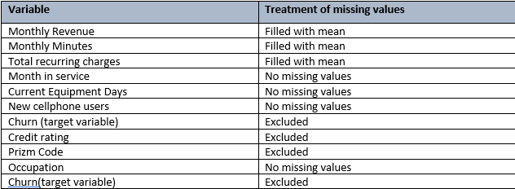
STUDY METHODOLOGY
The study is based on a subset of a large data set from Telco company. The dataset has 71,047 and 58 variables.
Only relevant 11 variables were filtered for the project analytics. Missing data on churn status was excluded from the study giving a reduction of observations to 51,047.
Treatment of missing values(summary)

Slide 7
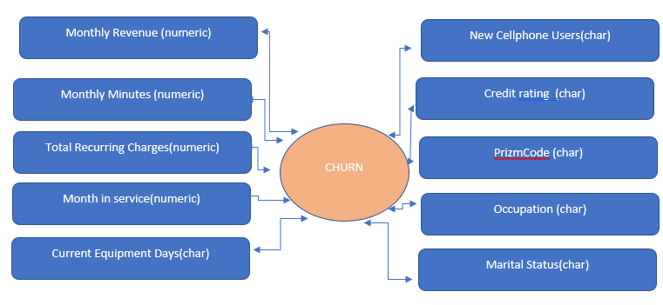
STUDY FRAMEWORK

Slide 8
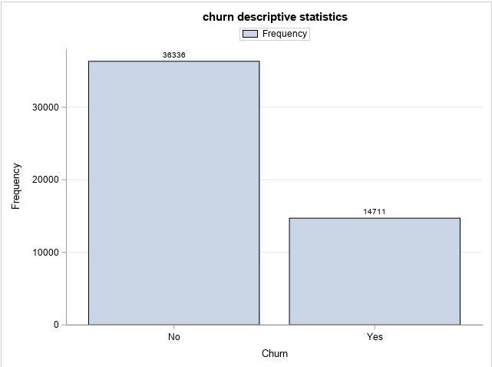
FREQUENCY OF CHURN
36336 (71.18%) active subscription
14711(28.82%) deactivated accounts

Slide 9
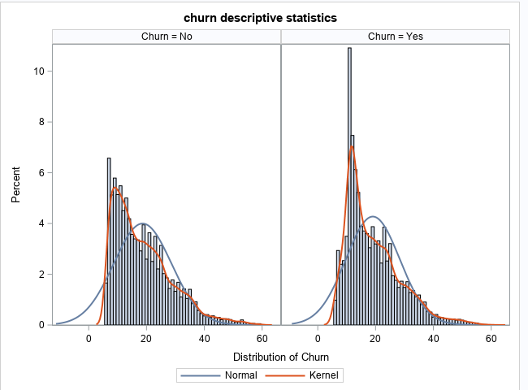
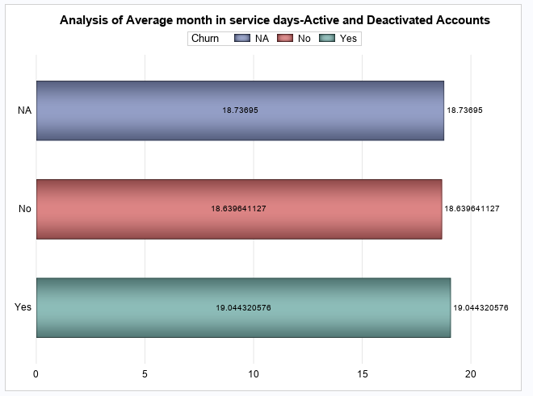
Analysis Of Active & Deactivated Accounts
Average customer life time is 18months for both active and deactivated.
Risk of loosing customers is around 18 to 20months after activation, more terminations expected

Slide 10
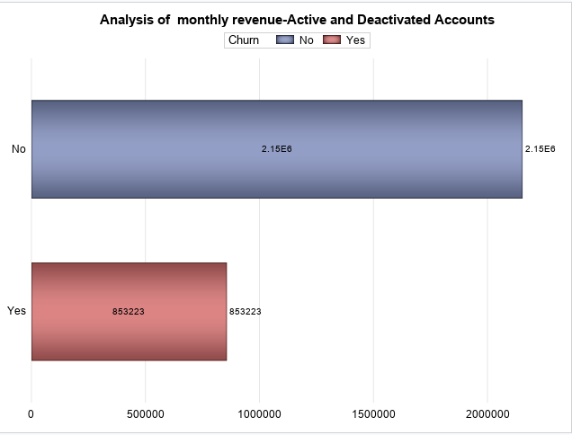
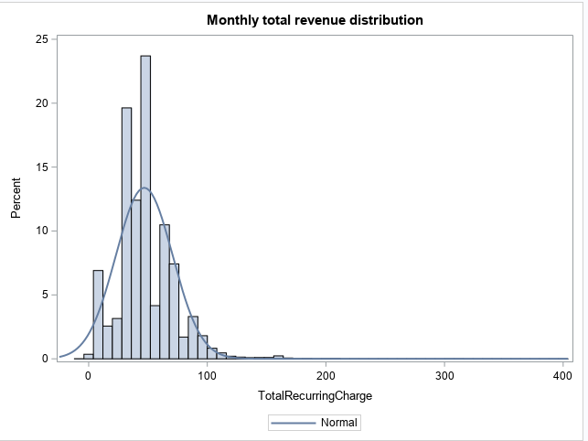
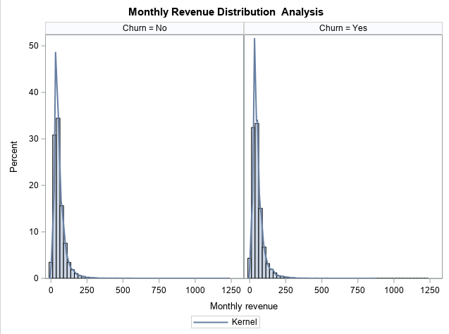
Revenue Analysis
Deactivations related to monthly charges
significant amount lost to date-$853k due to disconnections
most recurrent charges below $100 and a few exceptions above $100.00

Slide 11
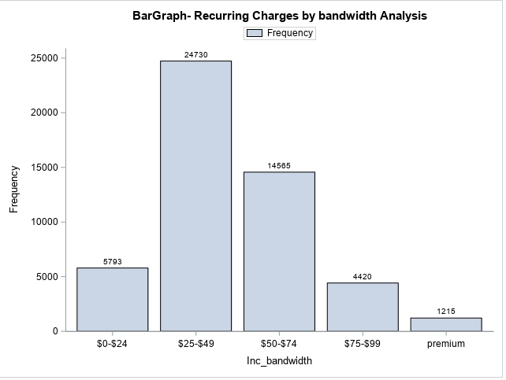
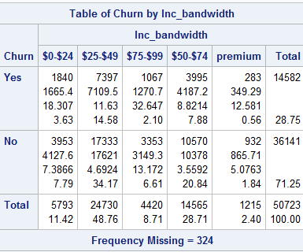
CRITICAL ANALYSIS OF REVENUE BANDS AND CHURN
More churn in those paying monthly subs of $25-$49
Also significant terminations from those paying between $50-$74 a month
More customers in the income bandwidth i.e those paying $25-$49, constitutes the bulk in thedatabase-48.76%

Slide 12
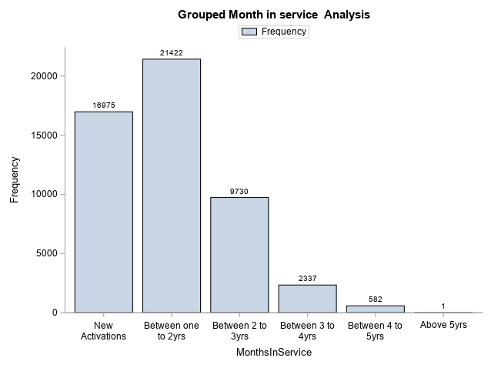
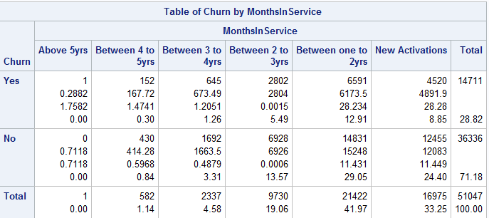
ANALYSIS OF CHURN BEHAVIOR-MONTH IN SERVICE GROUPS
Most Accounts deactivation between 12 and 24monts (12.91%)
High deactivation in less than a year(8.85%)

Slide 13
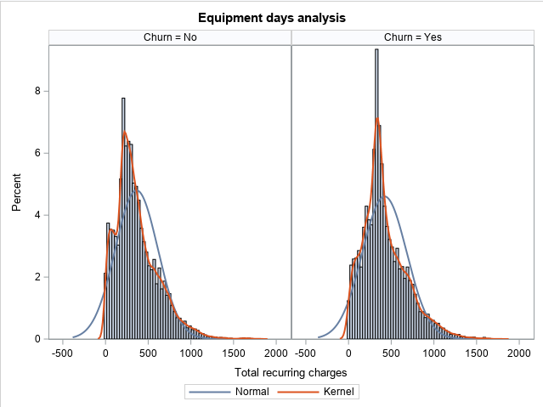
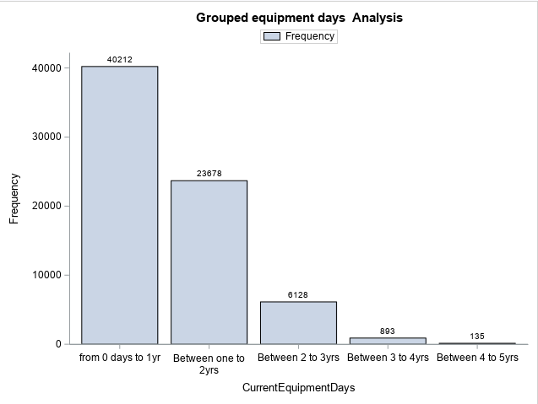
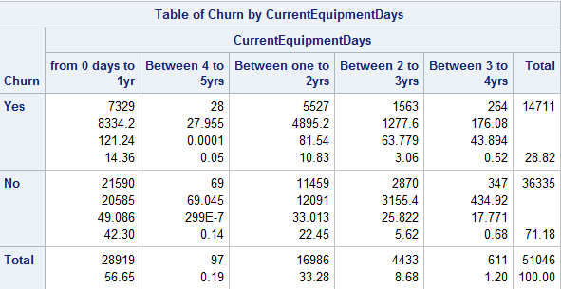
EQUIPMENT DAYS ANALYSIS
50% of the churners have equipment days less than one year
Most equipment days up to 2years

Slide 14
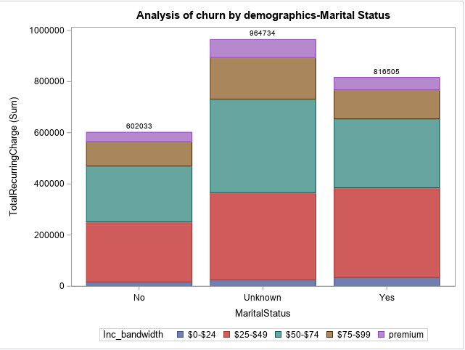
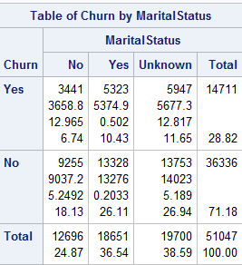
ANALYSIS OF CHURN AND MARITAL STATUS
Churn rate is related to marital status.
Excluding the unknown category, married people are leaving more than those not married(10.43%) compared to 6.74% for those who did not churn.
The rate is proportional to the total, as we have more married clients than not.

Slide 15
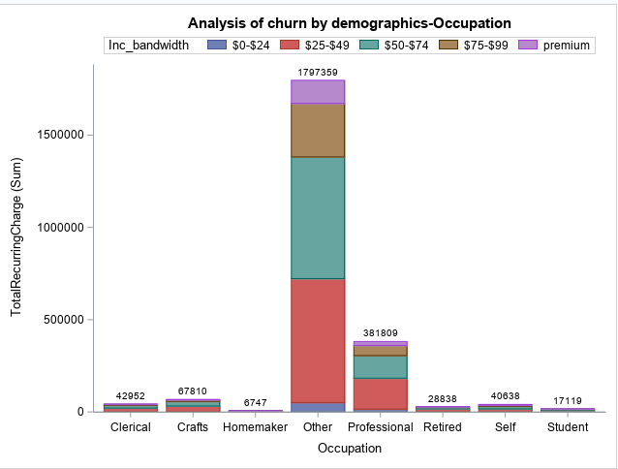
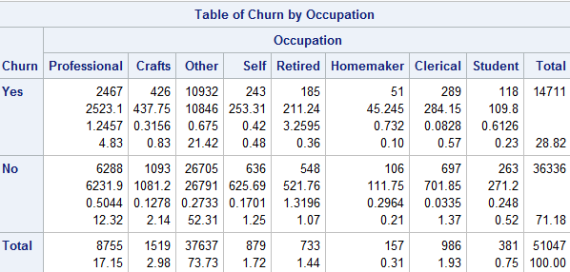
ANALYSIS OF CHURN AND OCCUPATION
Most people leaving in the other category
Professionals leaving at a significantly high proportion.
Numbers proportionally related to the totals in the subs data base.
Shows company not able to handle numbers, a clear sign of dissatisfaction amongst customers.

Slide 16
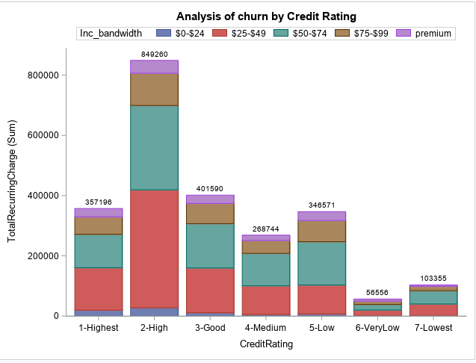
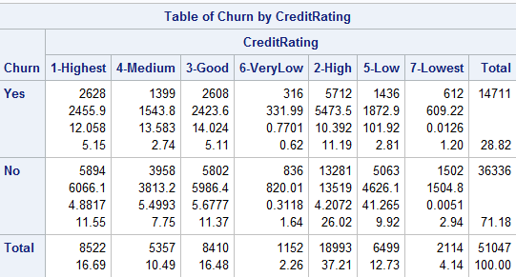
MONTHLY CHARGES ANALYSIS OF CHURN AND CREDIT RATING
company has fairly good client acquisition with best credit rating (1 and 2) with over 51%.
More deactivation also happening from those with good credit over 16%
Company has significant portion of unhealthy customers (19.13%) with bad credit, deactivation does exits in these groups (5 to 7)

Slide 17
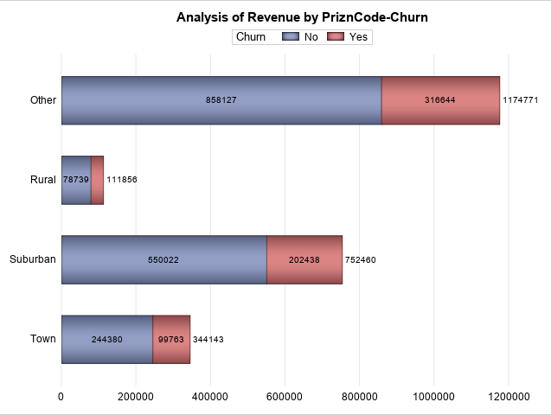
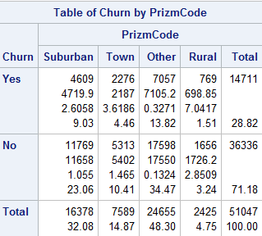
CHURN &REVENUE ANALYSIS BY AREA CODE
More churn in suburban areas excluding the others category
The revenue generated and loss is proportional to the clientele data base, more numbers more revenue and more terminations.
Need to investigate the other category

Slide 18
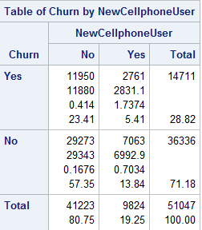
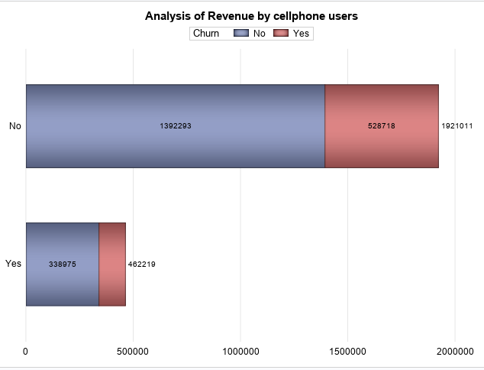
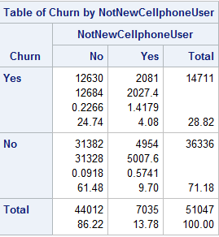
Cell phone user analysis
Even new cellphone user leaving(5.41%)
More churners on clients using own cell phones

Slide 19
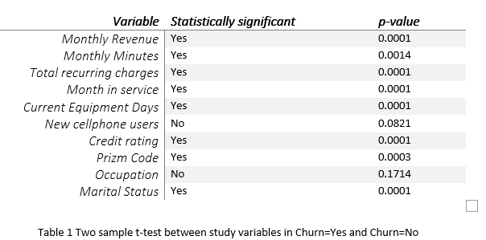
SAMPLE T-TEST FOR STUDY VARIABLE ANALYSIS
Inferential Analysis :
Visually, it appears that all variables are key determinants of churn behavior except occupation or whether someone got new cellphone or not.

Slide 20
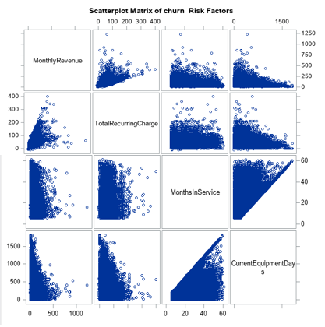
Scatterplot matrix
Plot of continuous data against other continuous variables
Assess for multicollinearity between independent variables

Slide 21
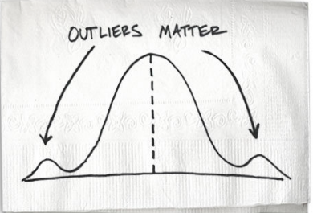
Outlier Analysis
Most of the data is right skewed. Outliers tend to be in the upper extremes.
Proc Univariate to identify 5 Number Summary
Upper limit = Q3 + 1.5(IQR)
Lower limit = Q1 – 1.5(IQR)
Outliers detected :
monthly revenue (296)
Total recurring charges (65) and
monthly minutes(124)
Separate grouping was created for all outliers to get a better distribution of the data

Slide 22
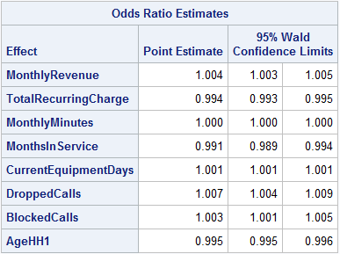
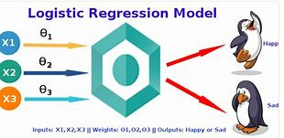
Logistic Regression
Backward Feature Elimination
Above are Features left (from framework)
Model concordance = 58.5%
Odds ratio =
e ^ (0.434 + 1.004(MR) + 0.994(TRC) + 1.000(MM)+ 0.991(MIS) + 1.001(CED) +1.007(DC)+1.003(BC) +0.995(AG))
For every one unit change in monthly revenue, the log odds of churn (versus not churn) increases by 1.004 etc.

Slide 23
SUMMARY FINDING
High customer disconnections at 28.82% against industry standard of 2.5% per 5million customers
Bulk of customers leaving around 20months,customer retention less than 2yrs, sign of customer frustration.
Most contributing income bandwidth/segments are those paying between $25-$49(48.76%) and $50-$74(28.71%)
Disconnections highly correlated to equipment's days
More churners from married customers (10.43%),professionals (4.83%)
Company losing more of customers with good credit ~16%
More revenue contributions from suburban areas and towns compared to rural communities

Slide 24
RECOMMENDATIONS
Company to focus on retention policy by conducting various market campaign strategies like running monthly or quarterly promotions, pricing strategies, expand product offering and or improve service delivery.
To better service the market, the company must identify needs by segments and link product offer to specific segments, (say age groups, geographical locations, marital status or occupation)
Optimise customer loyalty drivers, company must create loyalty groups and document loyalty indicators, say for stable married people, professionals etc.
Company must create powerful customer focused value proposition:
Relevance (solve problems), Quantifiable value (unique benefits) & differentiations.
Company must devise ways for managing total customer experience by conducting service quality surveys and customer support periodically.
Continue to focus more on customers with good credit as this will increase sales as revealed by the analysis and thrive to retain them.

Slide 25
APPENDIX
SAS PROCEDURES USED:
PROC FORMAT enables you to define your own informats and formats for variables
PROC PRINT prints the observations in a SAS data set
PROC CONTENTS shows the contents of a SAS data set and prints the directory of the SAS library
PROC MEANS provides data summarization tools to compute descriptive statistics for variables across all observations and within groups of observations
PROC FREQ produces one-way to n-way frequency and contingency (crosstabulation) tables
PROC SORT orders SAS data set observations by the values of one or more character or numeric variables
PROC UNIVARIATE provides a variety of descriptive measures, graphical displays, and statistical methods, which you can use to summarize, visualize, analyze, and model the statistical distributions of numeric variables
PROC SGPLOT creates one or more plots and overlays them on a single set of axes
PROC SGPANEL creates a panel of graph cells for the values of one or more classification variables
PROC SGSCATTER creates a paneled graph of scatter plots for multiple combinations of variables
PROC TTEST performs t tests and computes confidence limits for one sample, paired observations, two independent samples, and the AB/BA crossover design
PROC LOGISTIC investigate the relationship between these discrete responses and a set of explanatory

